Slide 1
Airspace
          The Categories and types of airspace are dictated by:
          The complexity or density of aircraft operations
          The nature of the operations conducted within the airspace
          The level of safety required
          The national and public interest

Slide 2
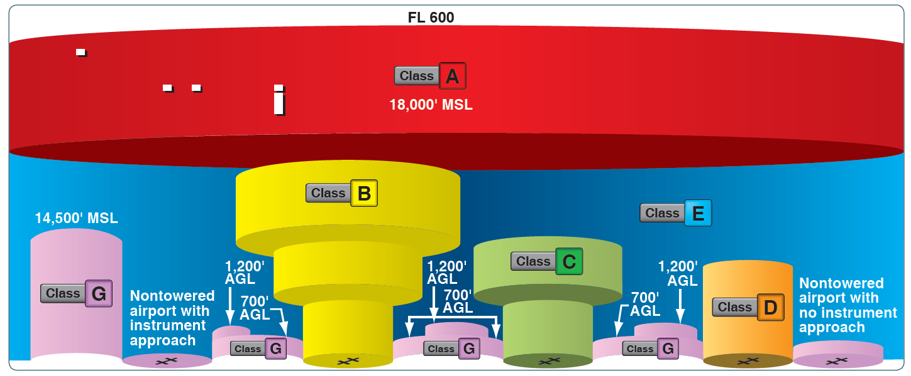

Slide 3
Airspace
Four (4) Airspace Designations:
1. Controlled
2. Uncontrolled
3. Special Use
4. “Other” Types

Slide 4
Airspace
Specific Types within the 4 Designations
              Controlled: Class A, B, C, D, E
              Uncontrolled: Class G
              Special Use
              “Other”Types

Slide 5
Airspace
A simple memory aid guide to the Alphabet Airspace of the United States:
Class A Airspace: “A” is for high “A”ltitude
Class B Airspace: “B” is for “B”ig Jets or “B”ig Cities
Class C Airspace: “C” is for “C”ommuter Jets or “C”orporate Jets
Class D Airspace: “D” is for “D”ialogue with the Control Tower
Class E Airspace: “E” is for “E”lsewhere
Class G Airspace: “G” for “G”round level

Slide 6
Airspace
Class E Airspace
--------------------------------------FL 600 (i.e. 60,000 ft MSL)--------------------
Class A Airspace
--------------------------------------FL 180 (i.e. 18, 000 MSL)----------------------
--------------------------------------Earth Surface------------------------------------
Operation Requirements for Class A Airspace
1) Pilot must be Instrument Rated
2) Aircraft must be equipped for IFR
3) Flight must be cleared on an IFR Flight Plan
4) All Aircraft set Altimeters to 29.92”

Slide 7
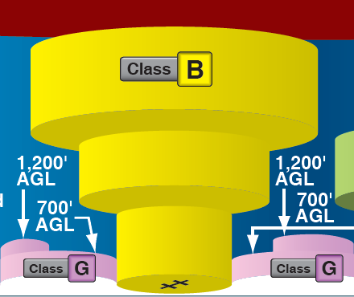

Slide 8
Airspace – Class B (Bravo)
Class B Airspace
      is depicted on the charts by solid blue concentric rings
      Shape of each site is individually designed.
      Vertically, the airspace is shaped much like an upside down wedding cake, with sectors affecting specific altitudes.

Slide 9
Airspace – Class B
Operation Requirements for Class B Airspace:
1) Typically surface to 10,000’ MSL surrounding the busiest airports
2) The Pilot must be authorized to Enter
(You must hear ATC say “NXXXXX is cleared into Class B)
3) All aircraft operating within 30 nm of the Primary Airport must have
an operable Mode C Transponder. (under or over Class B)
4) VFR Pilots must comply with Part 91 Visibility and Cloud Clearance Requirements. (3 Miles Visibility and Operate Clear of Clouds)
5) The pilot must be a certificated Private Pilot or an appropriately endorsed Student Pilot. Some Class B Airports prohibit Student Pilot Operations, (see the AIM (appendix D.4 for part 91, pg 294) for a listing of these.)
6) IFR Operations require an operating VOR receiver or suitable RNAV system

Slide 10
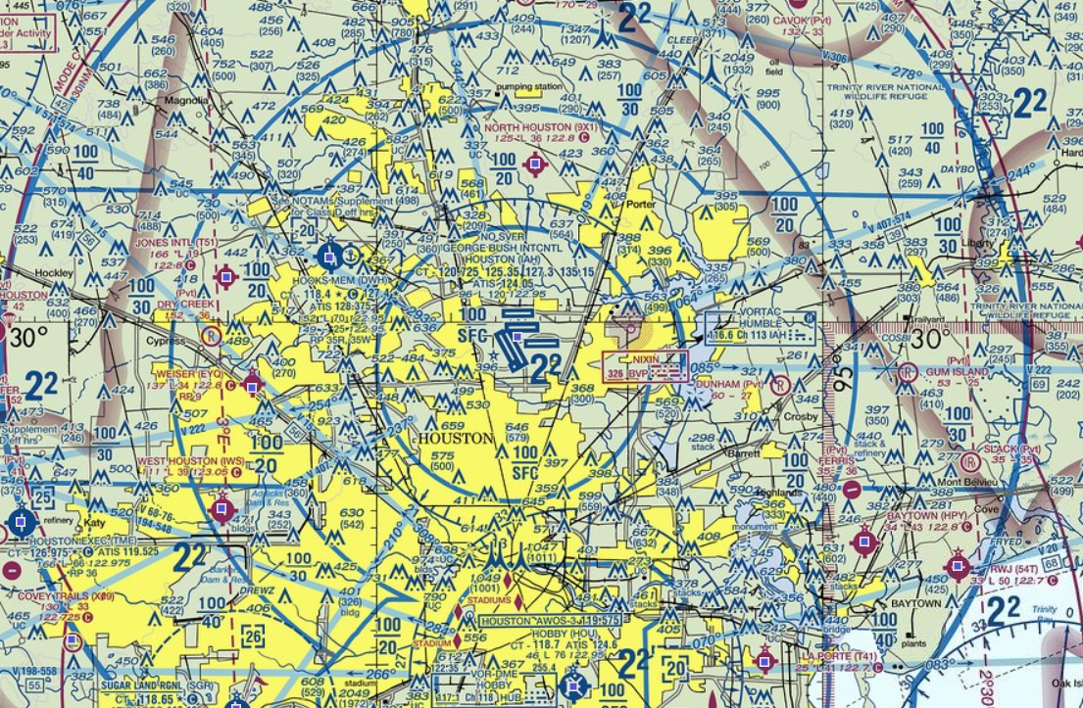
Sector Altitudes
100 Top of Sector
SFC Base of Sector
100 Top of Sector
20 Base of Sector

Slide 11
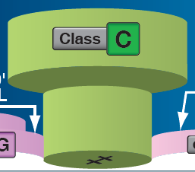

Slide 12
Airspace – Class C (Charlie)
Class C Airspace
- surrounding airport with operational control tower and serviced by radar approach control
- is depicted by two solid magenta rings,
- Airspace dimensions usually include:
          5 NM radius core, surface to 4,000’ AGL
          10 NM radius shelf area, 1,200’ AGL to 4,000’ AGL
          20 NM radius procedural “Outer Area” recommended but not compulsory initial contact point with ATC

Slide 13
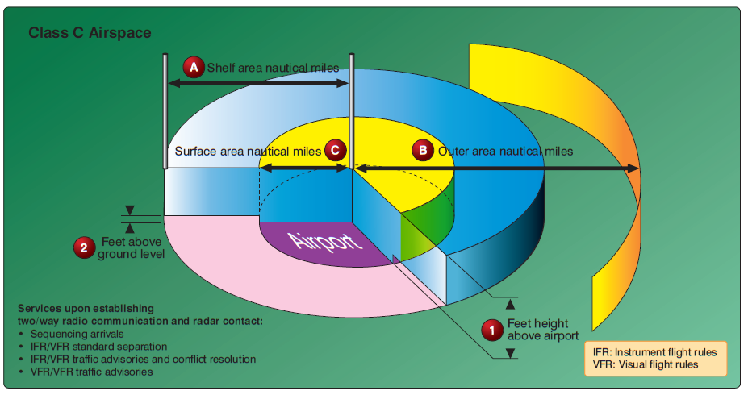
10 NM
5 NM
20 NM
1,200’ AGL
4,000’ AGL

Slide 14
Airspace – Class C
Operation Requirements for Class C Airspace:
1) Pilot must establish Two Way Communications with the ATC
Controlling Agency prior to entering.
(note: This is different from the required clearance for entering Class B)
2) All aircraft operating within Class C or Over flying Class C must have an
operable Mode C Transponder.
4) Two Way Communication with ATC not required when overflying Class C
3) VFR Pilots must comply with minimum visibility and cloud clearance
requirements to operate in Class C (see FAR 91.155) 3-152 Rule

Slide 15
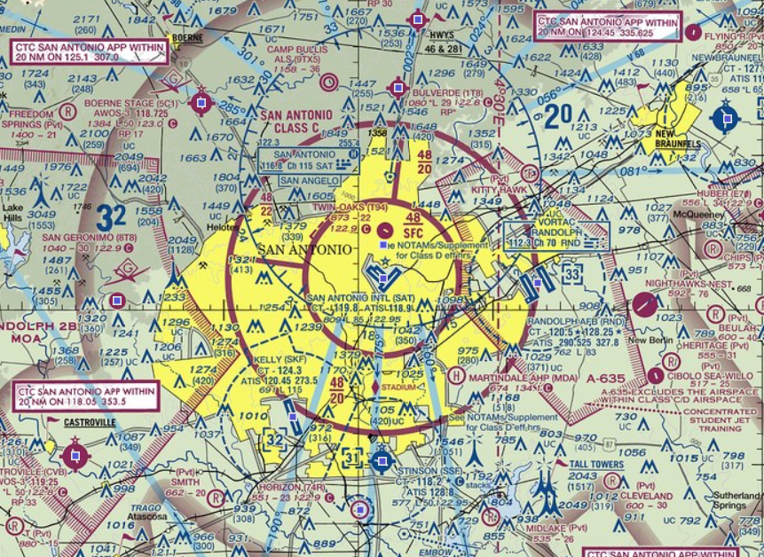
Sector Altitudes
48 Top of Sector
20 Base of Sector

Slide 16

- Surface to 2,500’ AGL
- Typically 4 nm radius from airport

Slide 17
Airspace – Class D (Delta)
Class D Airspace
  is designated for airports with operating ATC Control Towers
  (Airports Depicted by Blue Color).
  lateral dimension are depicted by blue dashed circle, most class D’s are 4 nm radius around the airport with extensions to accommodate IFR approaches but each class D airspace is individually tailored. (eg KSGR is 6 nm radius)
  Vertically, The top of the airspace is standardized at 2500 ft AGL,
  depicted by [##] in MSL.

Slide 18
Airspace – Class D
Operation Requirements for Class D Airspace:
1) Pilot must establish Two Way Communications with the ATC Control Tower prior to entering and maintain while in Class D.
(note: This is different from the required clearance for entering Class B)
2) VFR Pilots must have a minimum ceiling and visibility of 1000 ft and 3 miles to operate in Class D (see FAR 91.155 (c),(d))
3) A “Special VFR” Authorization may be requested by the Pilot if a minimum 1 mile Visibility and the ability to operate Clear of Clouds exists
4) Night Special VFR Authorizations only if IFR rated & Equipped (91.157)

Slide 19
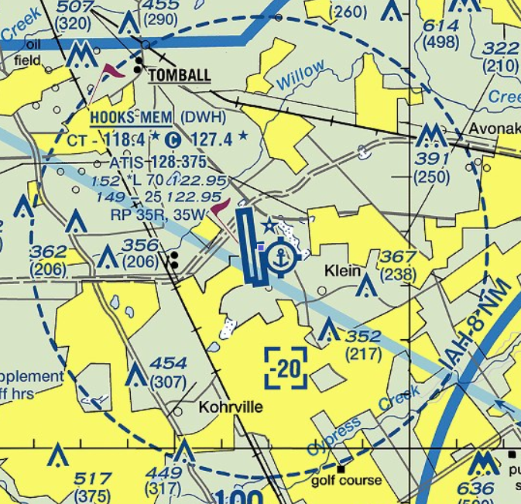
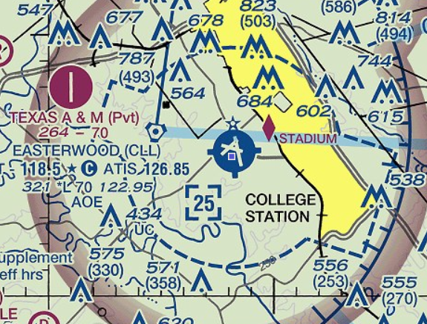

Slide 20
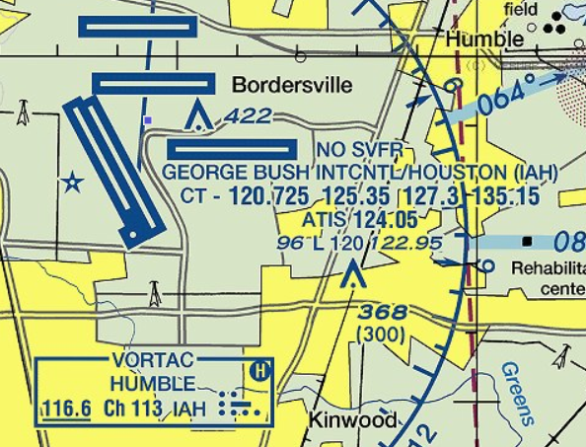
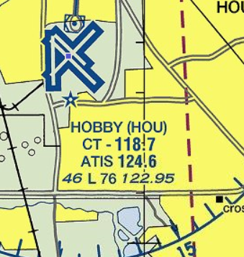
Airspace – Class D
At some Class B & D Airports (usually the Primary Airport in Class B),
“Special VFR” is prohibited.

Slide 21
Airspace – Class E (Echo)
Class E Airspace
  is all controlled airspace not classified as A, B ,C, or D
  defines airspace for the safe control and separation of aircraft during IFR operations
  Charts depict all Class E airspace with bases below 14,500’. If not charted, then Class E starts at 14,500’ and goes up to but not including 18,000’
  VFR Pilots must comply with minimum visibility & cloud clearance requirements
  to operate in Class E (see FAR 91.155)
  Memory Aid: 3-152 rule (below 10,000’ MSL)
  5-F111 rule (above 10,000’ MSL)

Slide 22
Airspace – Class E
Class E Airspace - Transition Areas
  Transition areas are depicted by magenta shaded areas
  Inside the magenta shading, the Class E base is 700’ AGL
  Outside the magenta shading, the Class E base is 1,200’ AGL
      (AIM 3-2-6: 3a)

Slide 23
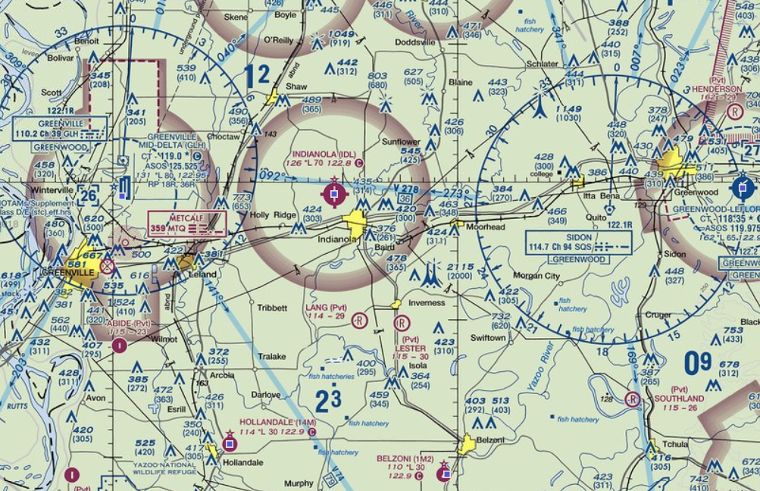

Slide 24
Airspace – Class E
Class E Airspace - Surface Area
  Some airports may have a Class E Surface area designated for the airport where a control tower does not exist or the control tower is not in operation
  depicted by magenta dashed lines surrounding the airport
  Dimension is standardized as 4 nm radius with extensions for IFR approaches

Slide 25
Airspace – Class E
Operation Requirements for Class E Airspace – Surface Area
  VFR Pilots must have a minimum ceiling and visibility of 1000 ft and 3 miles to operate in Class E surface areas (see FAR 91.155 (c),(d))
  A “Special VFR” Authorization may be requested by the Pilot if a minimum 1 mile Visibility and the ability to operate Clear of Clouds exists (FAR 91.157)
  Night Special VFR Authorizations only if IFR rated & equipped.

Slide 26
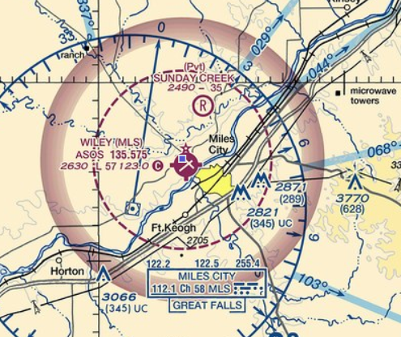
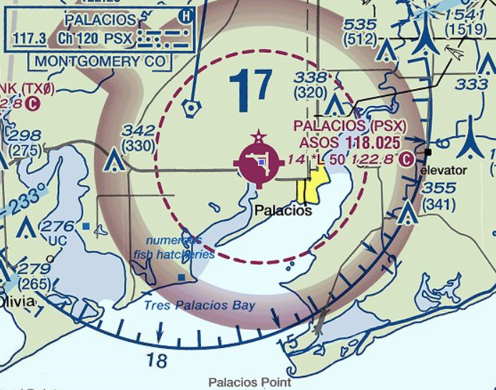

Slide 27
Airspace – Class E
Class E Airspace - Victor Airways
  Interstate highways of the sky
  Depicted by sold blue lines connecting VOR to VOR. Airways are designated by “V###”
  Lateral dimensions are 4 nm each side of airway centerline. (8 nm wide)
  Vertical dimensions are 1,200’ AGL up to but not including 18,000’

Slide 28
Airspace – Class E
Operation Requirements for Class E Airspace - VICTOR AIRWAYS:
1) Comply with Part 91 Visibility and Cloud Clearance Requirements.
(Memory Aid: 3-152 Rule and/or 5-F111 Rule)
2) Comply with the Cardinal Rule for Cruise Altitudes
(Mag Course 0-179: Odd Thousands + 500ft,(3500, 5500, 7500, …)
(Mag Course 180-359: Even Thousands + 500 ft. (4500, 6500, 8500, …)

Slide 30
Airspace – Class G (Golf) Uncontrolled Airspace
CLASS G AIRSPACE
    Exists over most of the USA, from the surface to 700’ AGL, or surface to 1,200’ AGL.
    Class G exists below Class E.
    This low level airspace allows VFR pilots to operate with minimum weather conditions and remain VFR

Slide 31
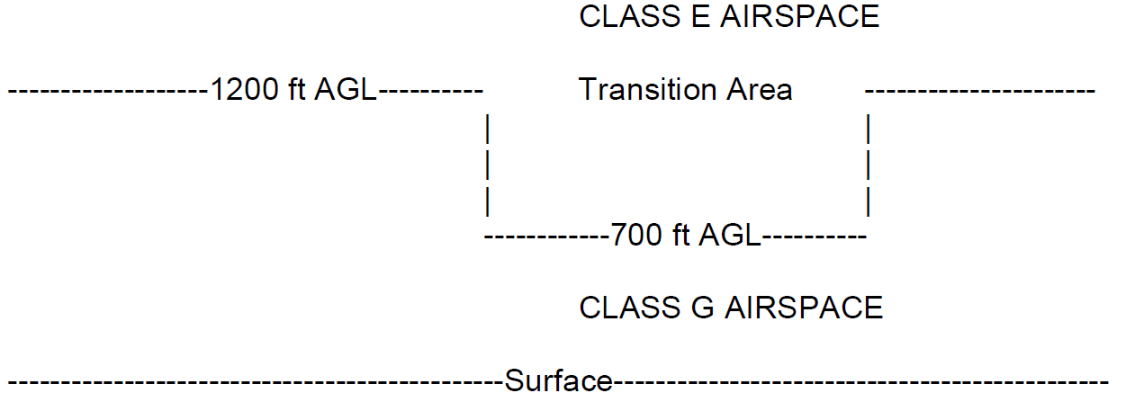
Airspace – Class G
Operation Requirements for Class G Airspace
    VFR Pilots must comply with Part 91 visibility and cloud clearance requirements
      Daytime: 1 SM visibility and operate clear of cloud
      Night time: 3 SM vis, 500’ below/ 1000’ above/ 2000’ hz clearance from clouds (152 rule)

Slide 32
Special Use Airspace - Prohibited
Prohibited Areas
    Depicted by area bordered by tight blue hatching
    Identified by label: “Prohibited P- ####”
    Placed over areas of sensitive National Security, eg: White House, Camp David
    Detailed information provided on the Sectional Chart side panel
    OPERTIONAL REQUIREMENTS:
      Authorization from the ATC Controlling Agency is required – unlikely
      Avoid Prohibited Areas at all times, monitor 121.5 for violation warnings & intercept by military

Slide 33
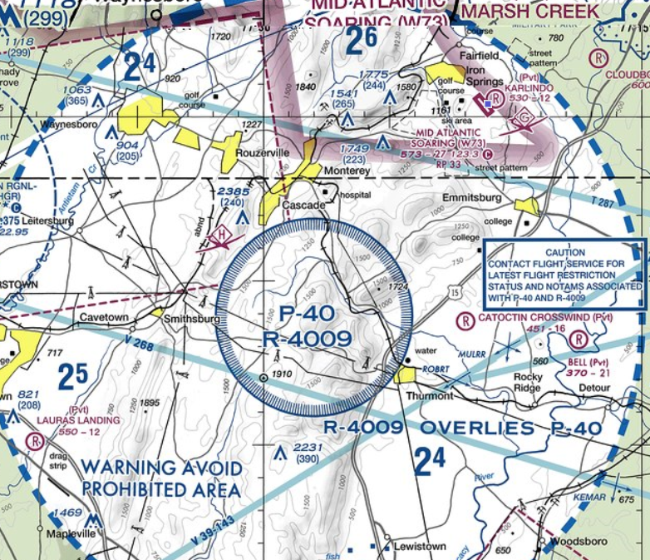
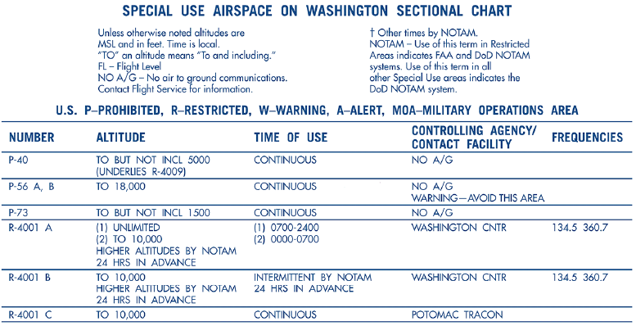
Special Use Airspace
Prohibited Areas
( from Sectional Chart side panel )

Slide 34
Special Use Airspace - Restricted
Restricted Areas
    Depicted by area bordered by blue hatching
    Identified by label: “Restricted R- ####”
    Detailed information provided on the Sectional Chart side panel
    OPERTIONAL REQUIREMENTS:
      Authorization from the ATC Controlling Agency is required

Slide 35
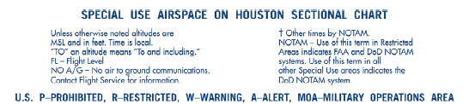
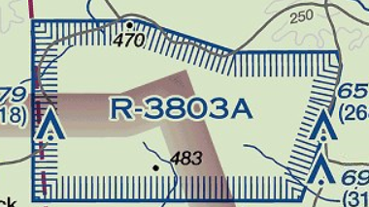
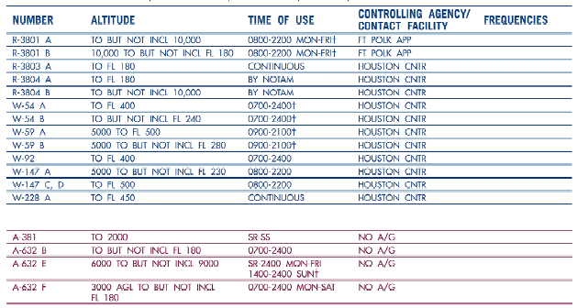
Special Use Airspace
Restricted Areas
( from Sectional Chart side panel )

Slide 36
Special Use Airspace - Warning
WARNING Areas
    Depicted by area bordered by blue hatching
    Identified by label: “Warning W- ####”
    Areas of extreme military activity, most are established beyond 3 mile limit off of US shorelines, therefore not considered US Airspace
    Detailed information provided on the Sectional Chart side panel
    OPERATIONAL REQUIREMENTS:
      Only requirement is see and avoid – exercise vigilance
      If flight through is required, recommend VFR flight following from ATC

Slide 37
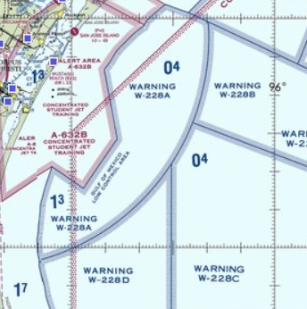
Special Use Airspace
Warning Areas
( from Sectional Chart side panel )

Slide 38
Special Use Airspace - MOA
Military Operating Areas (MOA)
    Depicted by magenta hatching
    Areas contain military training operations (such as aerobatic maneuvers)
    Pilots should use extreme caution if flying through an active MOA (“Hot”)
    To determine if the MOA is “Hot”, contact the ATC Controlling Agency or the nearest FSS

Slide 39
Special Use Airspace
Military Operating Areas (MOA) – Operational Requirements
    Extreme vigilance is the only requirement to fly through a “Hot” MOA
    It is highly recommended to remain clear of an active MOA
    Should flight through be required, It is recommended to contact the ATC controlling agency and participate in “VFR Flight Following”
    Detailed information provided on the Sectional Chart side panel

Slide 40
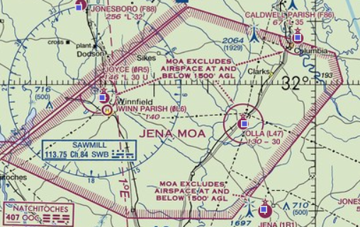
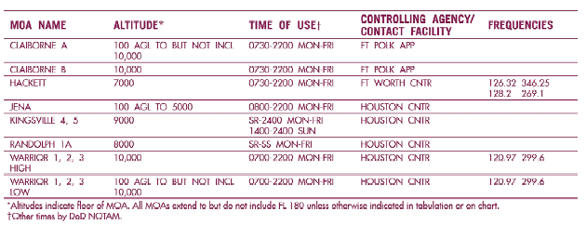
Special Use Airspace
Military Operating Areas (MOA)
( From Sectional Side Panel )

Slide 41
Special Use Airspace - ALERT
ALERT Areas
    Depicted by area bordered by magenta hatching
    Identified by label: “Alert A- ####”
    Areas of concentrated traffic, usually military or civilian student training
    Detailed information provided on the Sectional Chart side panel
    OPERATIONAL REQUIREMENTS:
      Only requirement is see and avoid – exercise vigilance

Slide 42
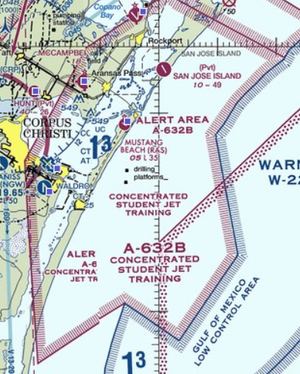
Special Use Airspace
Alert Areas
( from Sectional Chart side panel )

Slide 43
Special Use Airspace – Other
Terminal Radar Service Area (TRSA)
      is depicted on the charts by solid grey concentric rings
      shape of each site is individually designed.
      Vertically, the airspace is shaped much like an upside down wedding cake, with sectors affecting specific altitudes.
      TRSA is operationally similar to Class C Airspace

Slide 44
Special Use Airspace – Other
Operation Requirements - (TRSA)
      VFR participation is not mandatory
      VFR pilots not wishing to participate are requested to contact ATC approach control and state “Negative TRSA Service”

Slide 45
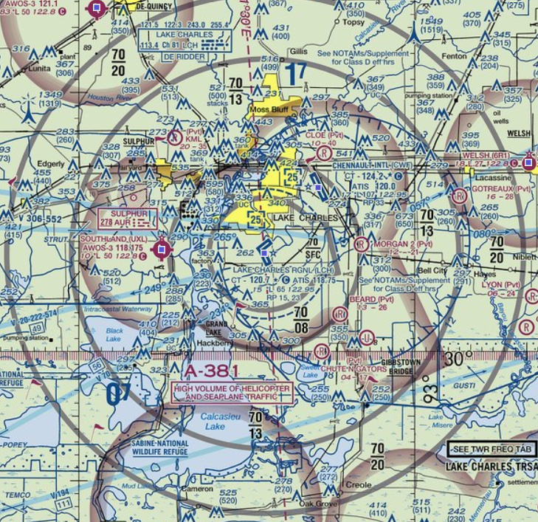
TRSA
Sector Altitudes
70 Top of Sector
08 Base of Sector

Slide 46
Special Use Airspace - other
Military Training Routes
    Depicted by solid straight, grey lines
    Identified by label on line: “VR ###” or “IR ###”
    Routes are used by military aircraft for high speed navigation training
    VR or IR #### (4 digits) operate below 1,500’ AGL
    VR or IR ### (2 or 3 digits) operate above 1,500’ AGL up to 10,000’ MSL
    OPERATIONAL REQUIREMENTS:
      Only requirement is see and avoid – exercise vigilance
      Contact FSS to inquire about operating times for routes along your flight path

Slide 47
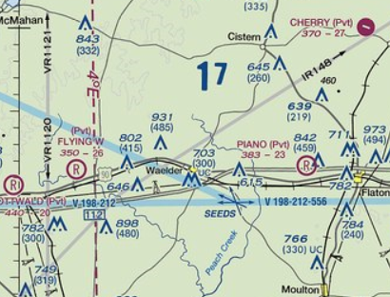
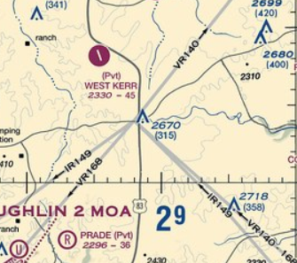
Special use Airspace – Other
Military Training Routes (MTR’s)

Slide 48
Special Use Airspace – OTHER
Temporary Flight Restrictions (TFR)
    Established by FDC NOTAM
    Notam provides location, effective time period, area defined in statute miles, and altitudes affected
    Pilot is responsible to check for TFR’s as part of the preflight planning process
    TFR’s and details available at www.tfr.faa.gov

Slide 49
Special Use Airspace – OTHER
Other Airspace Areas (PHOAK 15-4)
    Local Airport Advisory (LAA)
    Parachute jump aircraft operations
    Published VFR Routes
    National Security Areas (NSA)
    Air Defense Identification Zones (ADIZ)
    Flight Restricted Zones in vicinity of White House & Capital (FRZ)
    Wildlife and Wilderness Areas, National Parks
    NOAA Marine Areas

Slide 50
Airspace – VFR Weather Minimums

Slide 51
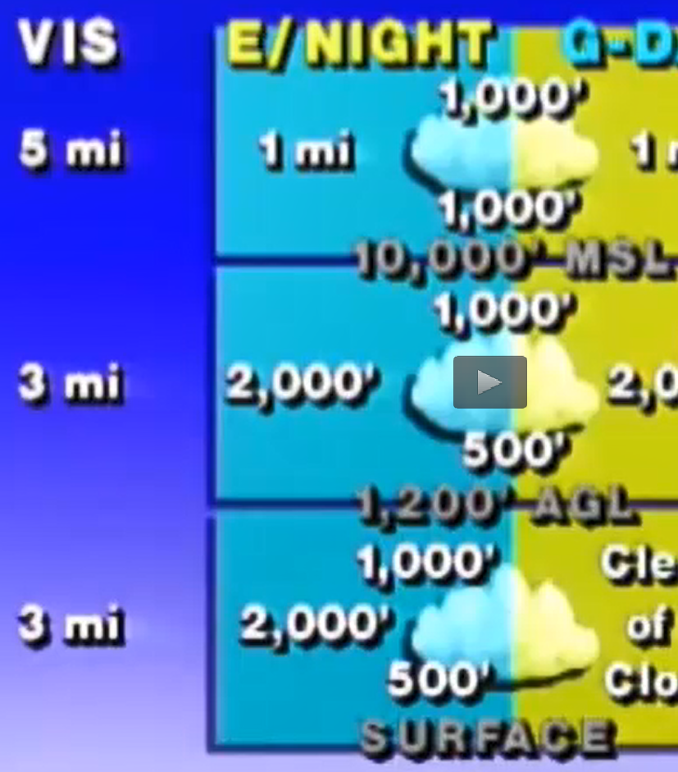
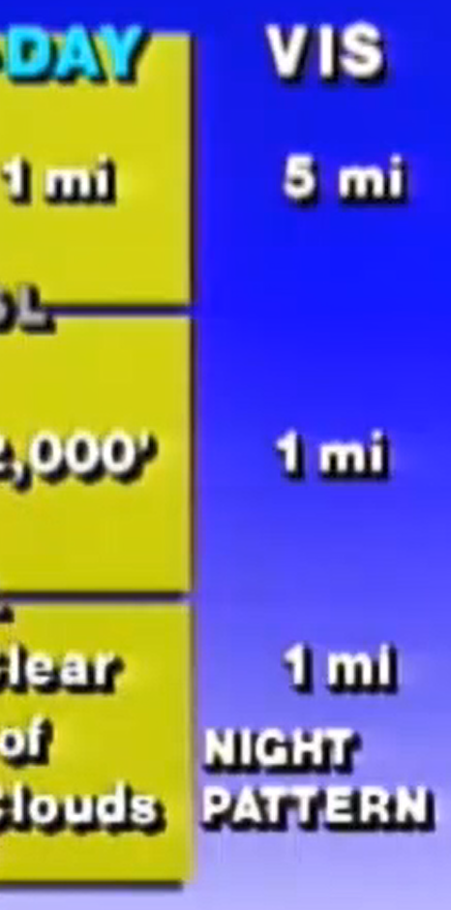


Slide 52
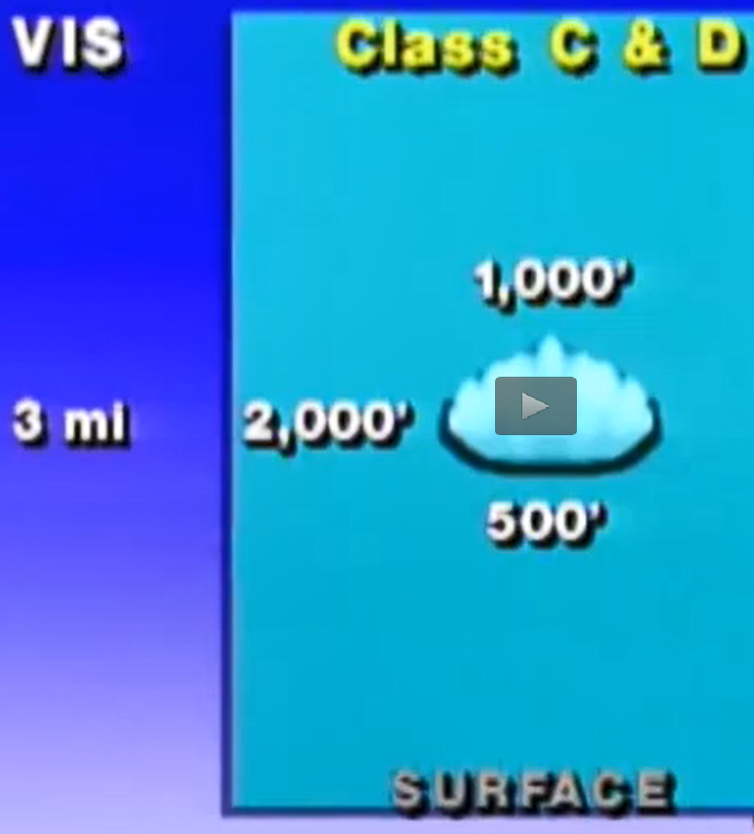



Slide 53
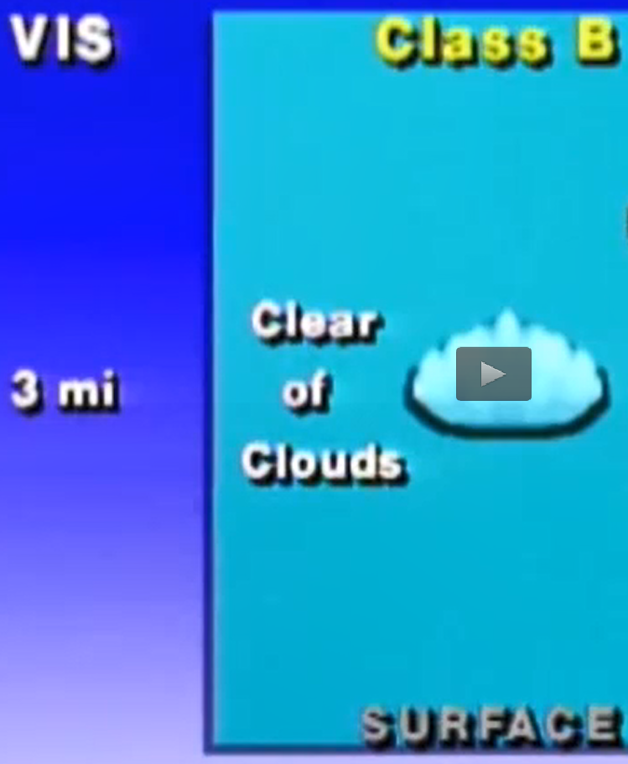



Slide 54
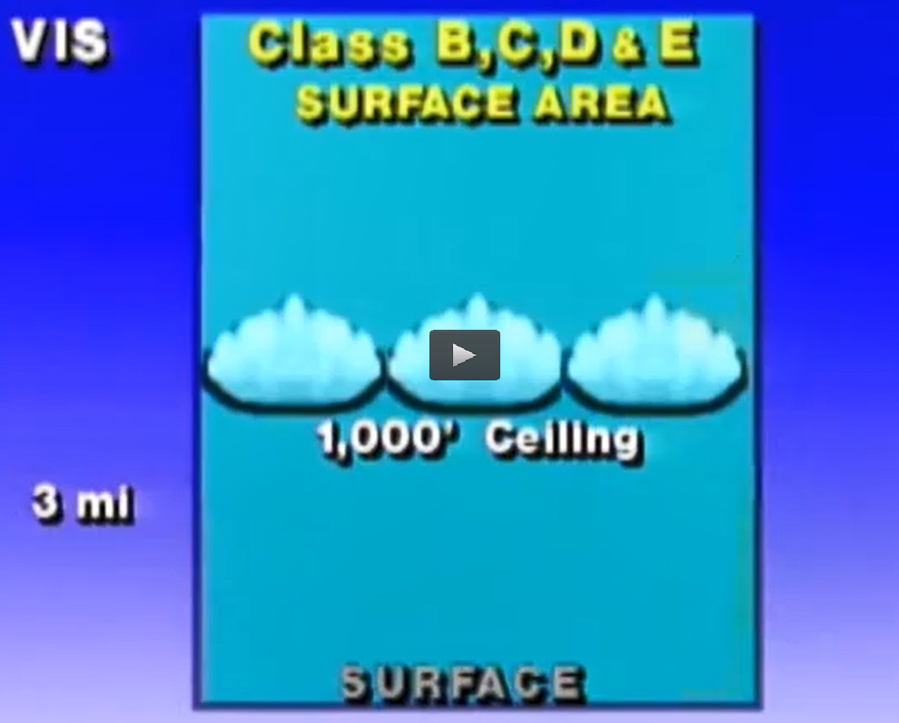

Slide 55
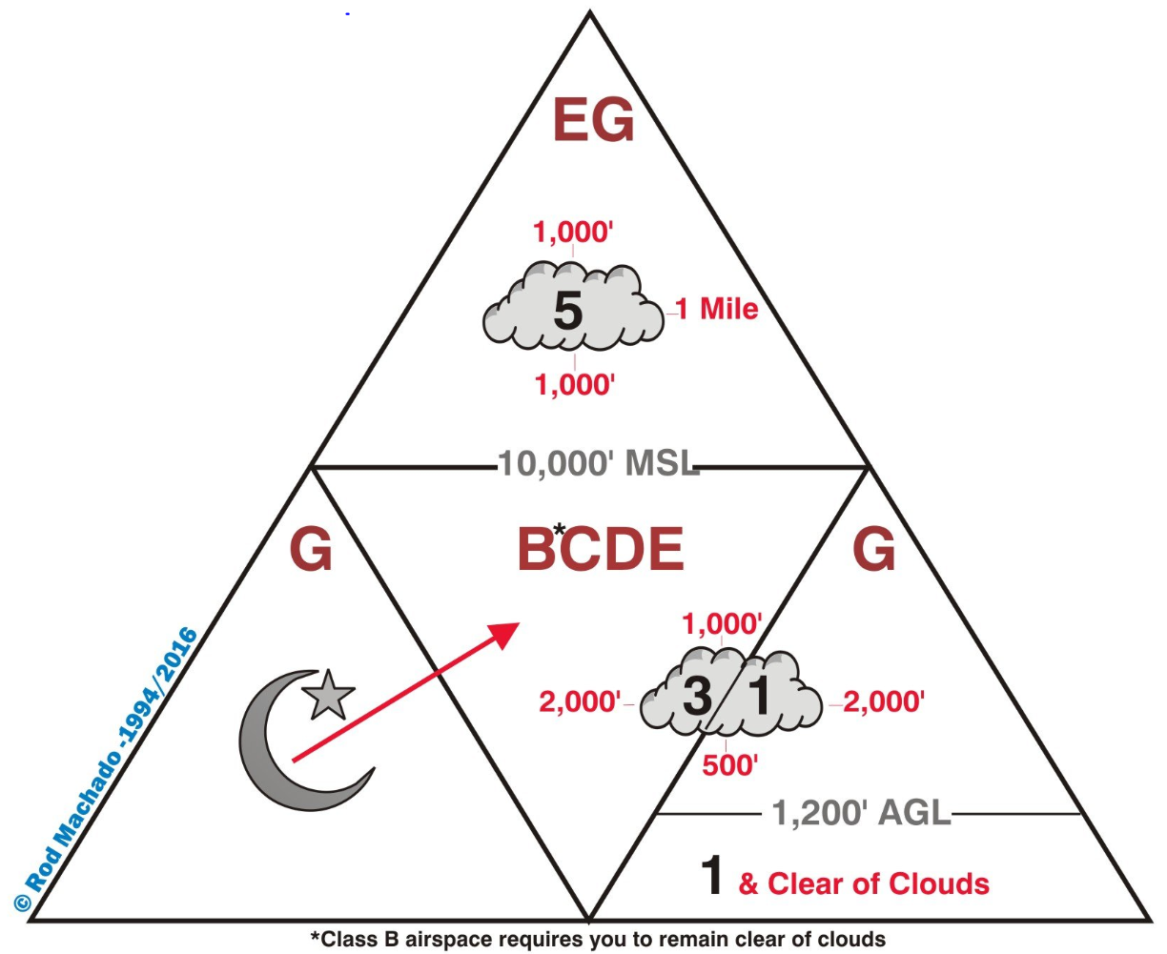

Slide 56
Airspace – Special VFR
Allows operations within controlled airspace in weather conditions less than basic
VFR
Provides IFR separation to VFR traffic
Must be requested by Pilot and approved by ATC (may be relayed by FSS)
Allowed within lateral boundaries of surface areas of Class B, C, D, or E airspace up to but not including 10,000’ MSL

Slide 57
Airspace – Special VFR
Special VFR Requirements
- Clearance from ATC
- Weather minimums: 1SM / clear of clouds
- Night: Pilot and aircraft must IFR rated & equipped
- If ground visibility is not reported, it may be replaced with 1 SM of flight
- Special VFR not allowed at certain large airports (noted on sectional chart)

Slide 58
